Slide 1




Introduction to Computation
Autumn, 2023
Prof. Fan Cheng
Shanghai Jiao Tong University
chengfan85@gmail.com
https://github.com/ichengfan/itc

Slide 2
Outline
Algorithm complexity
Exception
11

Slide 3
Algorithm complexity

Slide 4


Correctness and Performance
The most important thing to think about when designing and implementing a program is that it should produce results that can be relied upon.
Sometimes performance is an important aspect of correctness. This is most obvious for programs that need to run in real time. A program that warns airplanes of potential obstructions needs to issue the warning before the obstructions are encountered.

Slide 5
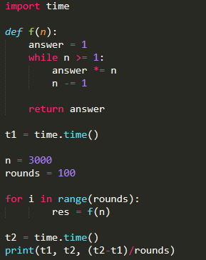
Time: measure performance
In Python, we can use the time module to study the running time of a program: https://docs.python.org/3/library/time.html
We could run the program on some input and time it. But that wouldn’t be particularly informative because the result would depend upon
the speed of the computer on which it is run
the efficiency of the Python implementation on that machine
the value of the input
The time depends on the machine and system. How to measure its running time in theory?
It is cumbersome to use time.time() or timeit.timeit()
We need a theory to predict the future
Nothing is practical than a good theory

Slide 6
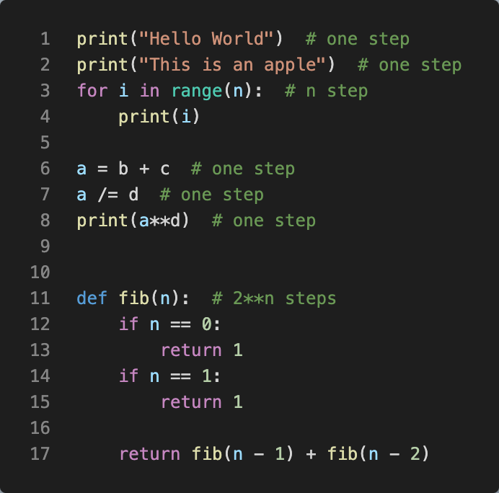
How to measure performance
Idea: computer programs consists of fundamental instructions like
+, -, *, /, //, %, if, =, print, input……
Regarded the running time of these instructions as “1”
For each program, just count how many fundamental instructions it contains
A step is an operation that takes a fixed amount of time, such as binding a variable to an object, making a comparison, executing an arithmetic operation, or accessing an object in memory
the number of steps may depend on the input

Slide 7
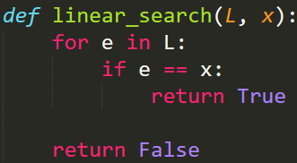
Worst-case Running Time
Both L and x will affect the running time
Best-case running time: the minimum running time over all the possible inputs of a given size
Worst-case running time: the maximum running time over all the possible inputs of a given size
Average-case running time: the average running time over all possible inputs of a given size

Slide 8
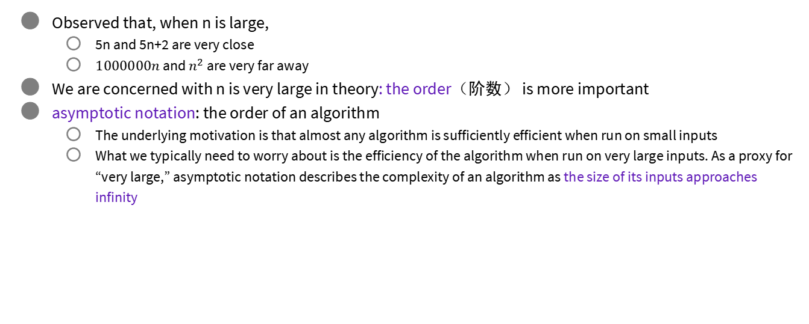
Asymptotic Notation
Observed that, when n is large,
5n and 5n+2 are very close
$1000000n$ and $n^{2}$ are very far away
We are concerned with n is very large in theory: the order（阶数） is more important
asymptotic notation: the order of an algorithm
The underlying motivation is that almost any algorithm is sufficiently efficient when run on small inputs
What we typically need to worry about is the efficiency of the algorithm when run on very large inputs. As a proxy for “very large,” asymptotic notation describes the complexity of an algorithm as the size of its inputs approaches infinity

Slide 9
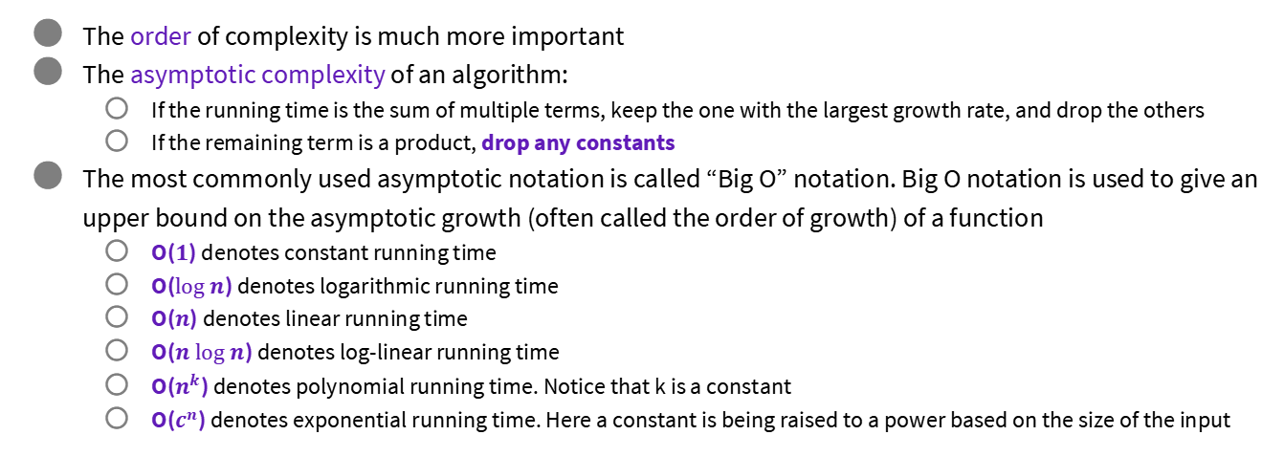
“Big O” notation
The order of complexity is much more important
The asymptotic complexity of an algorithm:
If the running time is the sum of multiple terms, keep the one with the largest growth rate, and drop the others
If the remaining term is a product, drop any constants
The most commonly used asymptotic notation is called “Big O” notation. Big O notation is used to give an upper bound on the asymptotic growth (often called the order of growth) of a function
O($1$) denotes constant running time
O($log⁡n$) denotes logarithmic running time
O($n$) denotes linear running time
O($n log⁡n$) denotes log-linear running time
O($n^{k}$) denotes polynomial running time. Notice that k is a constant
O($c^{n}$) denotes exponential running time. Here a constant is being raised to a power based on the size of the input

Slide 10
Asymptotic Notation: Summary
Not real time consumed by algorithms
Time approximated by steps.
If the size of input is large enough, asymptotic time complexity is accurate to compare the time complexity of algorithms
Understand time complexity is the foundation of computer science and engineering
From now on, when you write a program, you should be Very Very sensitive to the time complexity of your algorithm

Slide 11
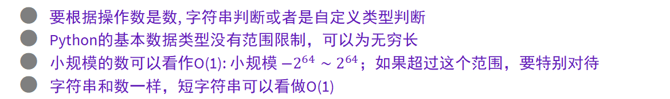
Complexity in Python statement
要根据操作数是数, 字符串判断或者是自定义类型判断
Python的基本数据类型没有范围限制，可以为无穷长
小规模的数可以看作O(1): 小规模 ${−2}^{64}∼2^{64}$；如果超过这个范围，要特别对待
字符串和数一样，短字符串可以看做O(1)
=, +, -, *, /, //, %, +=, -/=…, **
>=, >, <=, <, ==, !=
not
if…elif…else
print(), input(): 取决于输入类型的长度. 一般是O(1)
math.sin(), math.cos()
return
复杂语法由其定义决定
while()
for()
自定义类、函数def f():

Slide 12
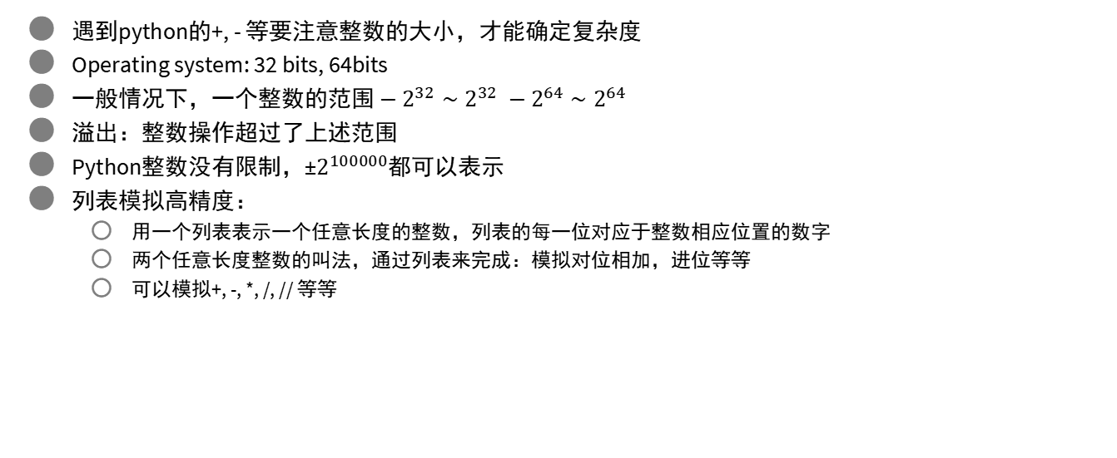
High Precision (高精度)
遇到python的+, - 等要注意整数的大小，才能确定复杂度
Operating system: 32 bits, 64bits
一般情况下，一个整数的范围 $−2^{32}∼2^{32} −2^{64}∼2^{64}$
溢出：整数操作超过了上述范围
Python整数没有限制，±$2^{100000}$都可以表示
列表模拟高精度：
用一个列表表示一个任意长度的整数，列表的每一位对应于整数相应位置的数字
两个任意长度整数的叫法，通过列表来完成：模拟对位相加，进位等等
可以模拟+, -, *, /, // 等等

Slide 13
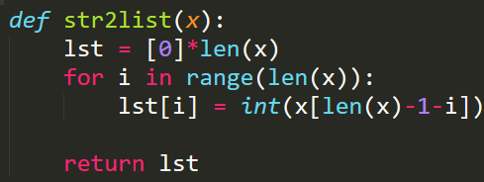
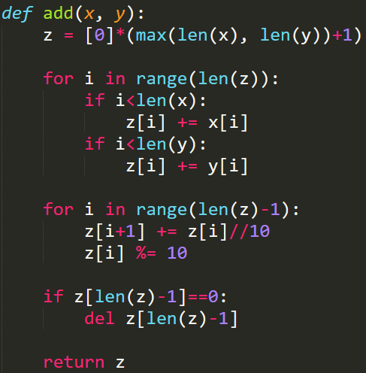
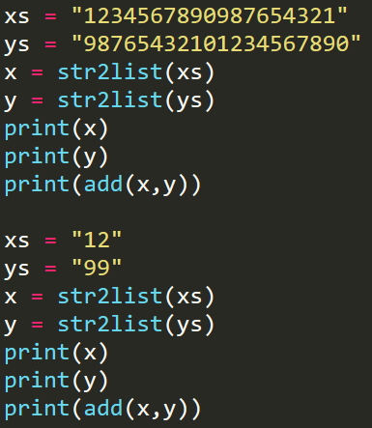
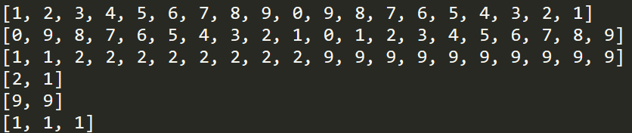
对位相加
进位
最高位进位
987
+ 123
1110
用字符串表示一个大整数

Slide 14
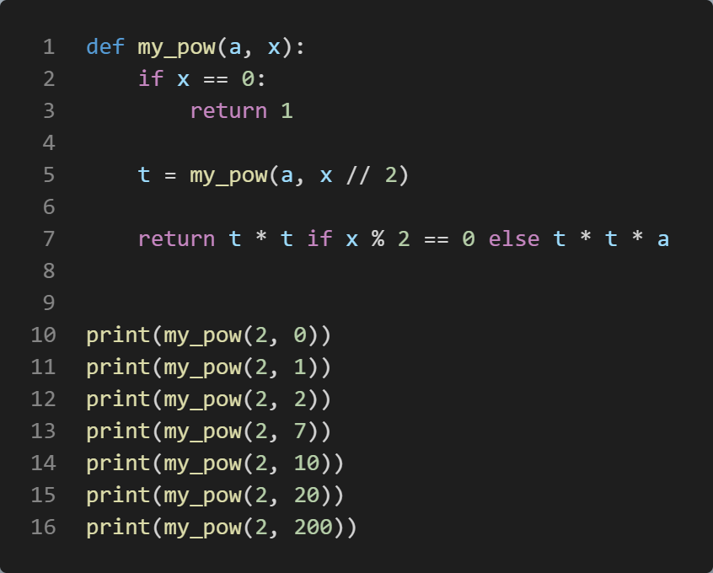
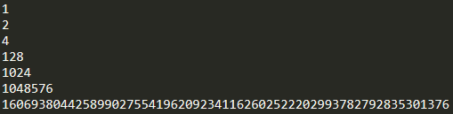
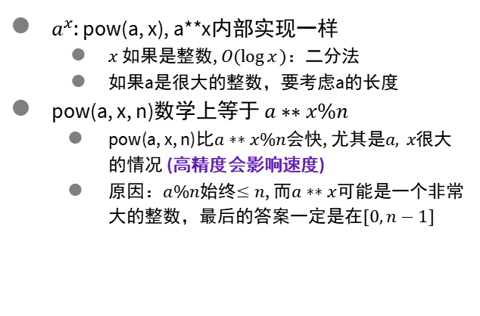
pow(), **
$a^{x}$: pow(a, x), a**x内部实现一样
$x$ 如果是整数, $O(\log{x})$：二分法
如果a是很大的整数，要考虑a的长度
pow(a, x, n)数学上等于 $a∗∗x\%n$
pow(a, x, n)比$a∗∗x\%n$会快, 尤其是$a, x$很大的情况 (高精度会影响速度)
原因：$a\%n$始终$≤n$, 而$a∗∗x$可能是一个非常大的整数，最后的答案一定是在$[0,n−1]$

Slide 15

Evaluate a Polynomial
$f_{n}\left(x\right)=a_{n}x^{n}+a_{n−1}x^{n−1}+…+a_{1}x+a_{0}$
Directly computation
Time complexity $O(nlogn)$
Horner’s rule
$f_{n}\left(x\right)=x\left(a_{n}x^{n−1}+…+a_{2}x+a_{1}\right)+a_{0}=xf_{n−1}\left(x\right)+a_{0}$
$f_{0}\left(x\right)=a_{n}$
Time complexity $O(n)$

Slide 16
列表的复杂度
列表的基本假设
列表中的元素在内存中是依次连续排列的
列表中的元素是通过下标访问的: lst[i]
访问一个元素是O(1)
在这两个假设下
插入 O(n)
查找 O(n)
删除 O(n)
所有的操作都要保证，经过操作后的数据结构依然是列表，即满足两个基本假设
依次连续排列才能保证通过下标访问
下标和元素一一对应
100 | 2 | 3 | 4 | 5 | 7 | 8 | -1 | -3 | -7

Slide 17
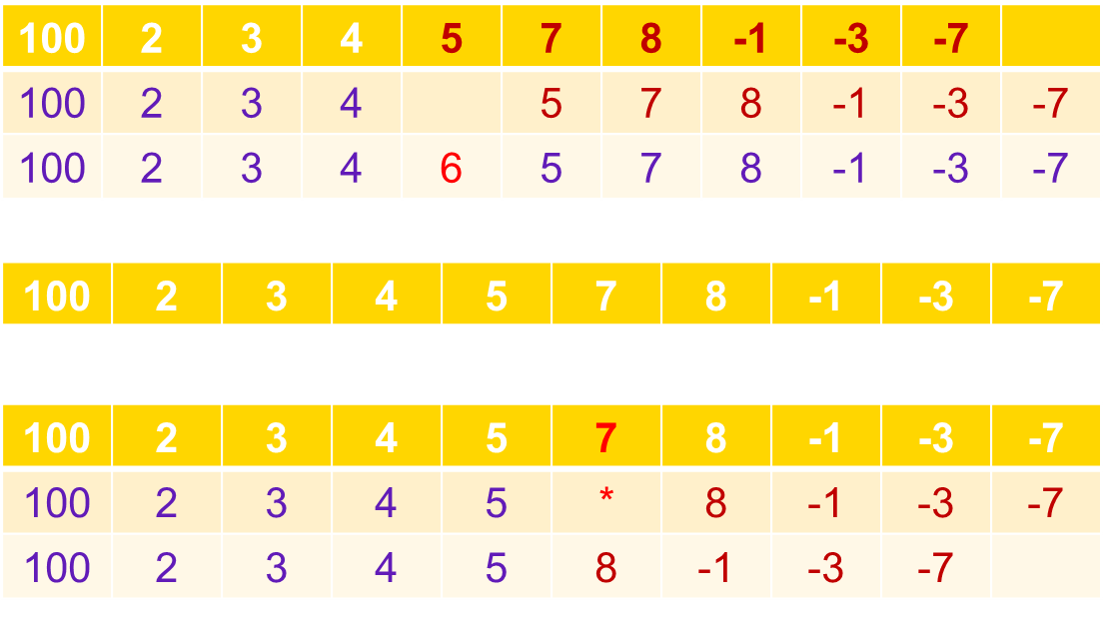
列表的复杂度
在基本假设下，如何自己实现插入、查找、删除
插入 O(n)
查找 O(n)
删除 O(n)
修改和插入很费时
不要一边遍历，一边修改

Slide 18
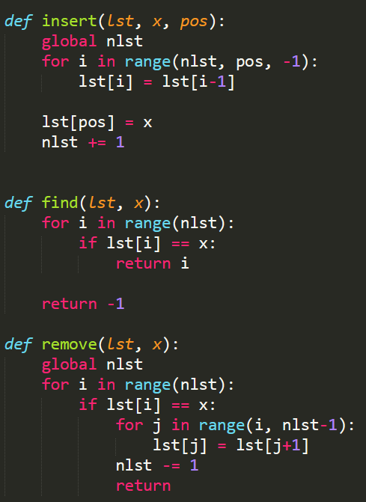
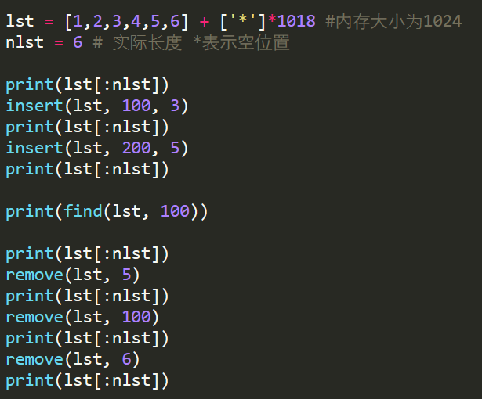
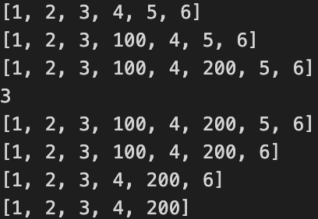
列表的复杂度
给一个1024长度的内存，模拟insert, remove, find. (用list模拟内存，list[i]第i个内存)

Slide 19
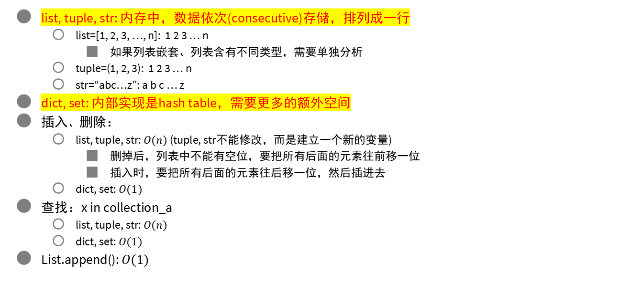
复合数据结构list, tuple, str, dict, set
list, tuple, str: 内存中，数据依次(consecutive)存储，排列成一行
list=[1, 2, 3, …, n]: 1 2 3 … n
如果列表嵌套、列表含有不同类型，需要单独分析
tuple=(1, 2, 3): 1 2 3 … n
str=“abc…z”: a b c … z
dict, set: 内部实现是hash table，需要更多的额外空间
插入、删除：
list, tuple, str: $O(n)$ (tuple, str不能修改，而是建立一个新的变量)
删掉后，列表中不能有空位，要把所有后面的元素往前移一位
插入时，要把所有后面的元素往后移一位，然后插进去
dict, set: $O(1)$
查找：x in collection_a
list, tuple, str: $O(n)$
dict, set: $O(1)$
List.append(): $O(1)$

Slide 20
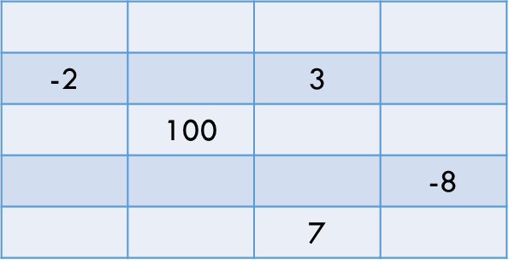
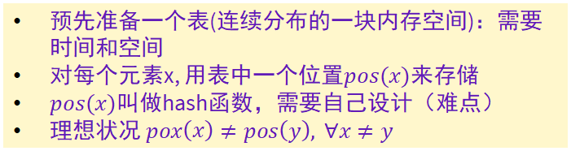
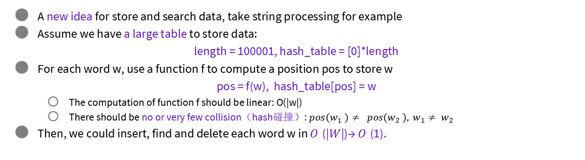
Hash (哈希) Table
预先准备一个表(连续分布的一块内存空间)：需要时间和空间
对每个元素x, 用表中一个位置$pos(x)$来存储
$pos(x)$叫做hash函数，需要自己设计（难点）
理想状况 $pox\left(x\right)≠pos\left(y\right), ∀x≠y$
A new idea for store and search data, take string processing for example
Assume we have a large table to store data:
length = 100001, hash_table = [0]*length
For each word w, use a function f to compute a position pos to store w
pos = f(w), hash_table[pos] = w
The computation of function f should be linear: O(|w|)
There should be no or very few collision（hash碰撞）: $pos(w_{1} )≠ pos(w_{2} ), w_{1}≠ w_{2}$
Then, we could insert, find and delete each word w in 𝑂(|𝑊|)→ 𝑂(1).

Slide 21
Hash (哈希) Table
预先准备一个表：需要时间和空间
对每个元素x, 用表中一个位置pos(x)来存储
The function f is called a hash function (hash： 混乱无章)
哈希函数的设计是有技巧的：为了避免冲突
table的length要足够大，越大越不容易碰撞 （空间需求大）
用空间换时间：O(1)来源于更大的空间
有碰撞可以解决（本课程不深入）
常用hash函数

Slide 22
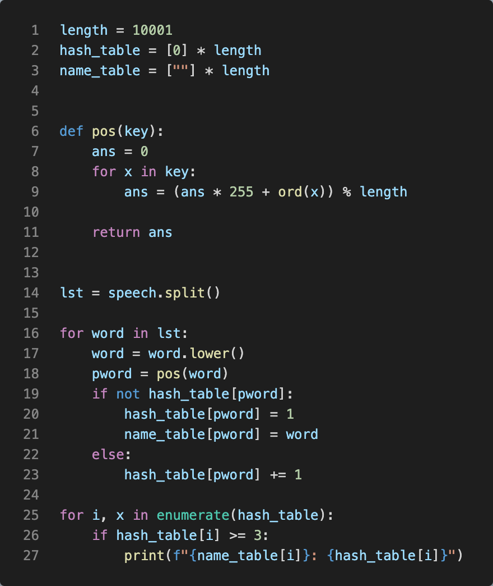
例子：实际中通过位置函数pos(x)来存储、查询
电影院直接告诉你座位在m排n列
宴会上会告诉你在第几桌几号位
不是顺序比较来查找
Hash函数pos(x)需要设计。假定字符都是ASCII码，即小于256，这里的pos(key)的设计，是把字符串看做一个256进制的整数
Hash函数的设计是一个很复杂的问题
No pain no gain
List: 插入、查找、删除都是O(n)
dict(), set(): 插入、查找、删除都是 O(1)
Hash table 的问题：初始化需要额外时间和空间
查找、插入、删除：O(1)
Python: __hash__()
尽量只初始化使用一个dict, set

Slide 23
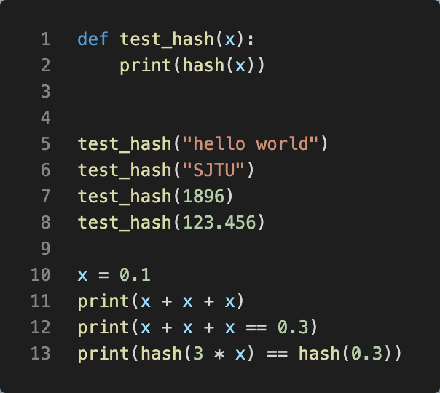
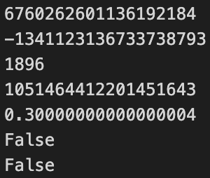
hash()
hash(object)
Return the hash value of the object (if it has one). Hash values are integers. They are used to quickly compare dictionary keys during a dictionary lookup. Numeric values that compare equal have the same hash value (even if they are of different types, as is the case for 1 and 1.0).
For objects with custom __hash__() methods, note that hash() truncates the return value based on the bit width of the host machine. See __hash__() for details.

Slide 24
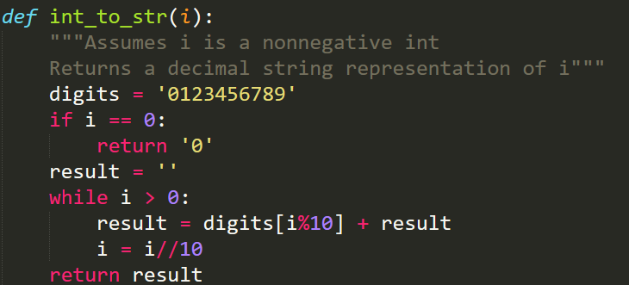
Example I

Slide 25
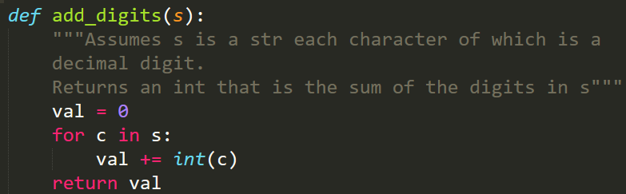
Example II

Slide 26
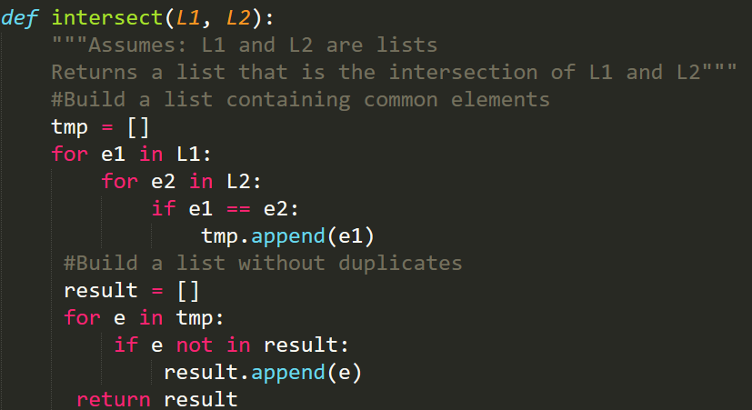
Example III

Slide 27
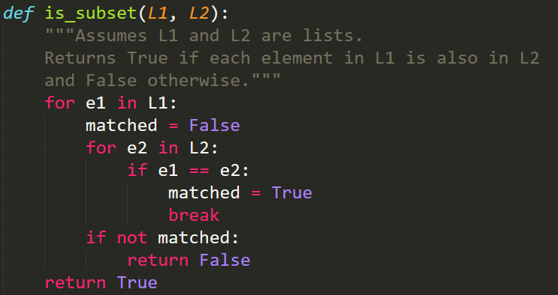
Example IV

Slide 28
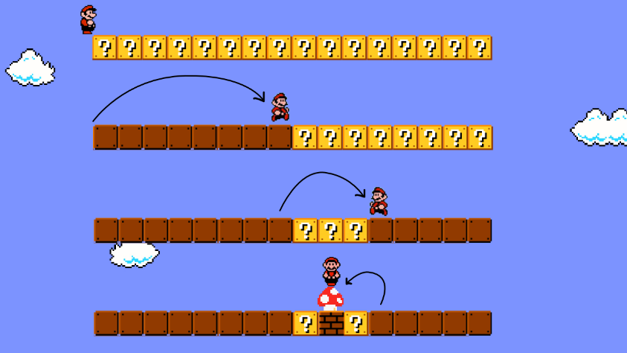
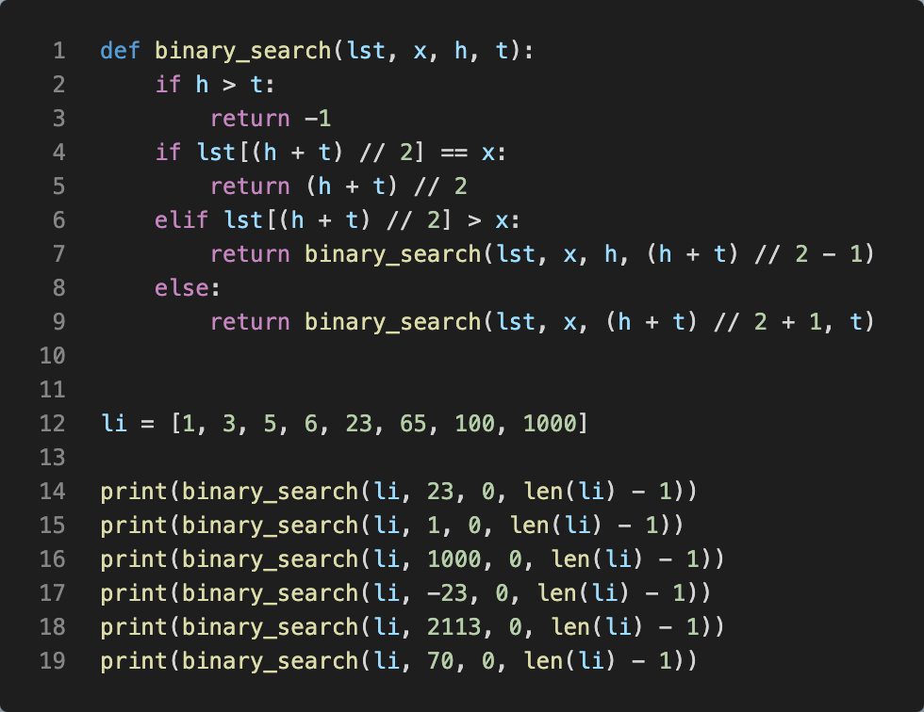

Binary Search
对于从小到大排好序的列表，每次和中间的元素比较，可以排除掉一半的元素
Sorted list, Binary search: O(log n)
in : O(n)
注意+1， -1
用while实现

Slide 29
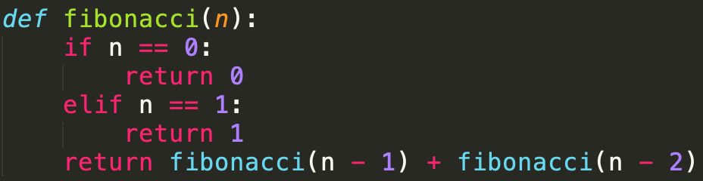

Example VI: Fibonacci sequence
$Fib(n+2) = Fib(n+1) + Fib(n):$
Time complexity ≈$O(2^{n})$
$T(n+2)=T(n+1)+T(n)$
$T(n)=O\left({\left(\frac{1+\sqrt{5}}{2}\right)}^{n}\right)$
每个$Fib(n)$都被重复计算

Slide 30
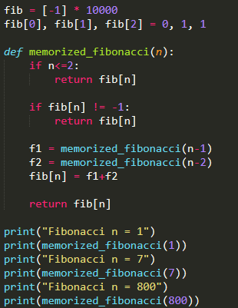
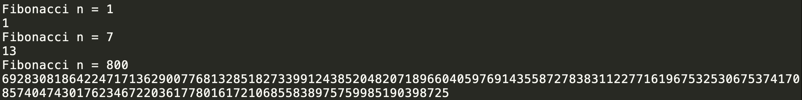
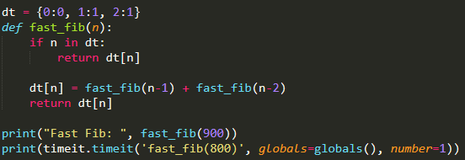
Example VI: Speed Up Fibo.
Tips: use a list (or dict) lst to store the intermediate results to speed up the computation
Each item in lst is initialized as -1
When invoke f(n), we could check lst[n] to see whether lst[n] had been computed before
If so, just return f(n)
Otherwise, we invoke the recursive function to compute f(n) and store it in lst[n]

Slide 31
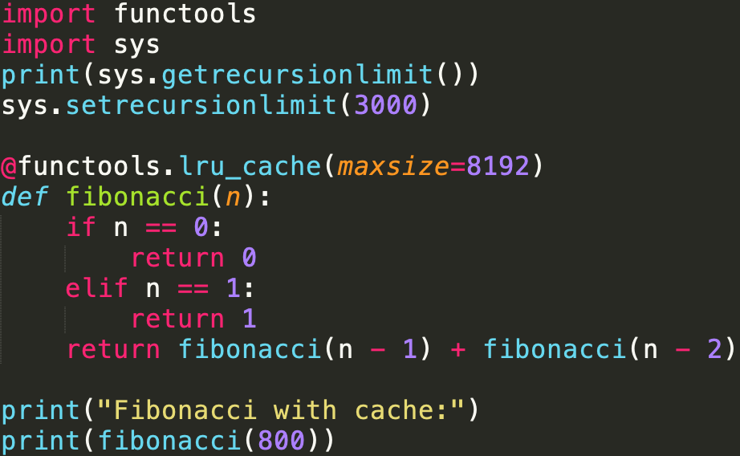
Python cache mechanism
仅供了解 ☺

Slide 32
Exercise
Fibonacci序列
gcd
合并两个list
合并两个排序好的list
测试list, set的效率
从时间复杂度可以类似的定义空间复杂度

Slide 33

Exception

Slide 34
Even grammar is correct
三者的平衡：用户、程序员、Python解释器
x * (y/z)
>>> 10 * (1/0)
Traceback (most recent call last):
File "<stdin>", line 1, in <module>
ZeroDivisionError: division by zero
x + y*3
>>> 4 + spam*3
Traceback (most recent call last):
File "<stdin>", line 1, in <module>
NameError: name 'spam' is not define
x + 2
>>> '2' + 2
Traceback (most recent call last):
File "<stdin>", line 1, in <module>
TypeError: Can't convert 'int' object to str implicitly
It is not an error. It is an Exception
Your code is correct. Users do not follow your instructions.

Slide 35
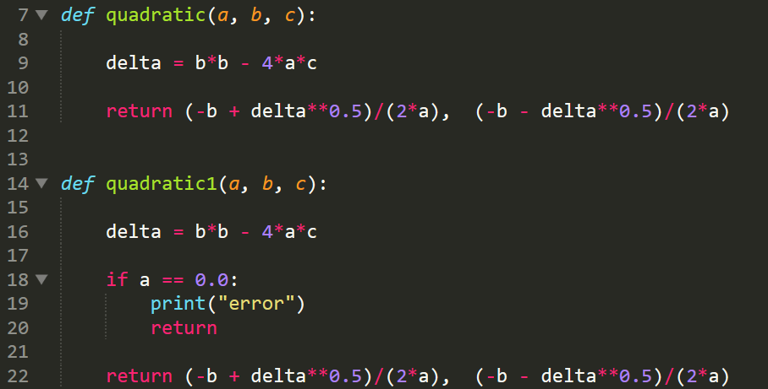

Exception: solution
Another example
Windows C++ programming
ReadFromFile(file_name):
In our mind,
filename = "C:\\Helloworld\\1.txt"
ret = ReadFromFile("C:\\Helloworld\\1.txt")
In practice, we need to
Check whether the file exist
Check whether the file can be opened
Check whether the return value ret is valid
It is too distracting. I only want to read from a file!
Quadratic formula $f(x)=ax^{2}+bx+c$, ($a≠0$)
We assume that $a≠0$, but….
干扰了正常的业务逻辑

Slide 36
Exception
Errors detected during execution are called exceptions and are not unconditionally fatal
Even if a statement or expression is syntactically correct, it may cause an error when an attempt is made to execute it.
Most exceptions are not handled by programs, however, and result in error messages as shown here
The last line of the error message indicates what happened. Exceptions come in different types, and the type is printed as part of the message:
the types in the example are ZeroDivisionError, NameError and TypeError
Built-in exceptions:
https://docs.python.org/3/library/exceptions.html#bltin-exceptions

Slide 37
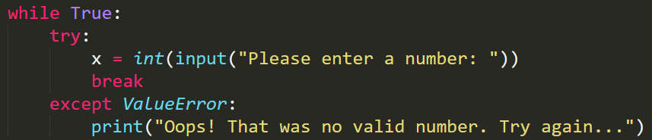
Handling Exception: Try except
Two keywords try and except
First, the try clause (the statement(s) between the try and except keywords) is executed. If no exception occurs, the except clause is skipped and execution of the try statement is finished
If an exception occurs during execution of the try clause, the rest of the clause is skipped. Then if its type matches the exception named after the except keyword, the except clause is executed, and then execution continues after the try statement
If an exception occurs which does not match the exception named in the except clause, it is passed on to outer try statements; if no handler is found, it is an unhandled exception and execution stops with a message as shown above

Slide 38

Exercise
Find potential sources of runtime errors in this code snippet:
dividend = float(input("Please enter the dividend: "))
divisor = float(input("Please enter the divisor: "))
quotient = dividend / divisor
quotient_rounded = math.round(quotient)
for x in range(a, b):
print("({},{}, {})“.format( my_list[x]))
Add a try-except statement to the body of this function which handles a possible IndexError, which could occur if the index provided exceeds the length of the list. Print an error message if this happens:

Slide 39
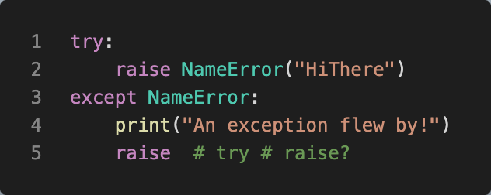
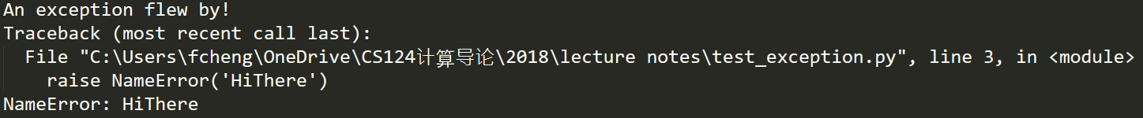
Raise
>>> raise NameError(‘HiThere’)
Traceback (most recent call last):
File "<stdin>", line 1, in <module>
NameError: HiThere
>>>raise ZeroDivisionError()
>>>raise ZeroDivisionError
>>>raise TypeError
>>>raise TypeError()
>>>raise ValueError
If you need to determine whether an exception was raised but don’t intend to handle it, a simpler form of the raise statement allows you to re-raise the exception:
The raise statement allows the programmer to force a specified exception to occur.

Slide 40
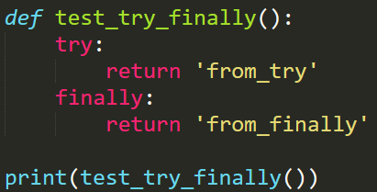
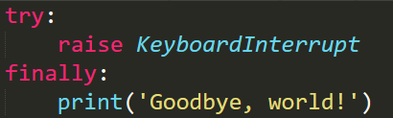
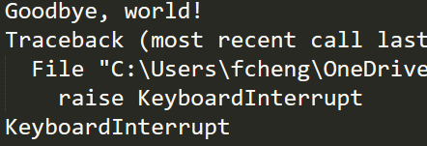
Clean up: try … finally(终极)
The try statement has another optional clause which is intended to define clean-up actions that must be executed under all circumstances.
A finally clause is always executed before leaving the try statement, whether an exception has occurred or not. (不管咋样都执行)
When an exception has occurred in the try clause and has not been handled by an except clause (or it has occurred in an except or else clause), it is re-raised after the finally clause has been executed.
The finally clause is also executed “on the way out” when any other clause of the try statement is left via a break, continue or return statement.
As you can see, the finally clause is executed in any event. The TypeError raised by dividing two strings is not handled by the except clause and therefore re-raised after the finally clause has been executed.
In real world applications, the finally clause is useful for releasing external resources (such as files or network connections), regardless of whether the use of the resource was successful.

Slide 41
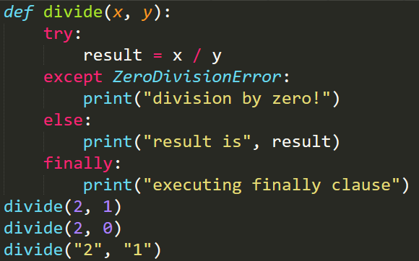
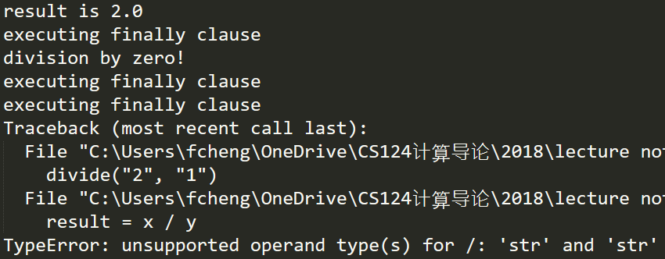
Exception: else
The try … except statement has an optional else clause, which, when present, must follow all except clauses. It is useful for code that must be executed if the try clause does not raise an exception.
The use of the else clause is better than adding additional code to the try clause because it avoids accidentally catching an exception that wasn’t raised by the code being protected by the try … except statement.
else will be executed only if the try clause doesn’t raise an exception(无异常时执行else)

Slide 42
Predefined Clean-up Actions
Some objects define standard clean-up actions to be undertaken when the object is no longer needed, regardless of whether or not the operation using the object succeeded or failed. Look at the following example, which tries to open a file and print its contents to the screen.
for line in open("myfile.txt"):
print(line, end="")
The problem with this code is that it leaves the file open for an indeterminate amount of time after this part of the code has finished executing. This is not an issue in simple scripts, but can be a problem for larger applications.
The with statement allows objects like files to be used in a way that ensures they are always cleaned up promptly and correctly.
with open("myfile.txt") as f:
for line in f:
print(line, end="")
After the statement is executed, the file f is always closed, even if a problem was encountered while processing the lines. Objects which, like files, provide predefined clean-up actions will indicate this in their documentation(确保文件关闭)

Slide 43
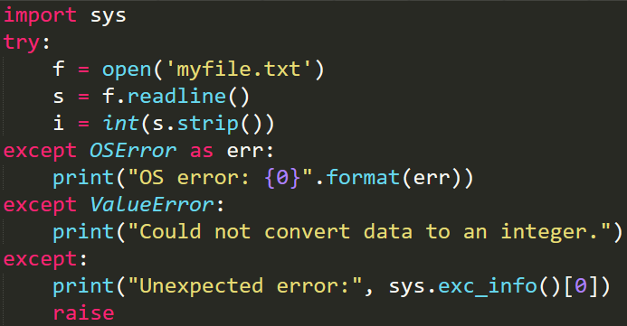
More on try and except
A try statement may have more than one except clause, to specify handlers for different exceptions.
At most one handler will be executed. Handlers only handle exceptions that occur in the corresponding try clause, not in other handlers of the same try statement.
An except clause may name multiple exceptions as a parenthesized tuple, for example:
... except (RuntimeError, TypeError, NameError):
... pass #do nothing
The last except clause may omit the exception name(s), to serve as a wildcard. Use this with extreme caution, since it is easy to mask a real programming error in this way! It can also be used to print an error message and then re-raise the exception (allowing a caller to handle the exception as well)
try 语句可以有多个 except 子句，用于指定不同异常的处理程序。
最多执行一个处理程序。处理程序仅处理相应 try 子句中发生的异常，而不处理同一 try 语句的其他处理程序中发生的异常。
except 子句可以将多个异常命名为带括号的元组，例如：
...除了 （RuntimeError， TypeError， NameError）：
... 什么都没通过 #do
最后一个 except 子句可以省略异常名称，以用作通配符。使用时要格外小心，因为以这种方式很容易掩盖真正的编程错误！它还可用于打印错误消息，然后重新引发异常（允许调用方也处理异常）

Slide 44
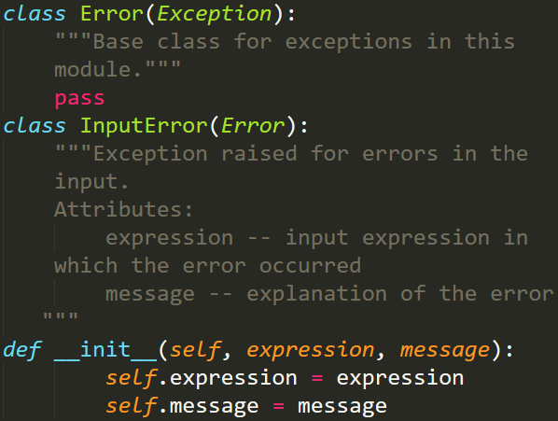

User Defined Exception
程序可以通过创建新的异常类来命名自己的异常（有关 Python 类的更多信息，请参阅类）。
异常通常应直接或间接派生自 Exception 类。
可以定义异常类，这些类可以执行任何其他类可以执行的任何操作，但通常保持简单，通常只提供许多属性，这些属性允许异常处理程序提取有关错误的信息。
在创建可能引发多个不同错误的模块时，一种常见的做法是为该模块定义的异常创建一个基类，并为该基类创建不同的错误条件的特定异常类：
仅供了解 ☺
Programs may name their own exceptions by creating a new exception class (see Classes for more about Python classes).
Exceptions should typically be derived from the Exception class, either directly or indirectly.
Exception classes can be defined which do anything any other class can do, but are usually kept simple, often only offering a number of attributes that allow information about the error to be extracted by handlers for the exception.
When creating a module that can raise several distinct errors, a common practice is to create a base class for exceptions defined by that module, and subclass that to create specific exception classes for different error conditions:

Slide 45


Error checks vs exception handling

Slide 46

Exercise
This function adds an element to a list inside a dict of lists. Rewrite it to use a try-except statement which handles a possible KeyError if the list with the name provided doesn’t exist in the dictionary yet, instead of checking beforehand whether it does. Include else and finally clauses in your try-except block:

Slide 47


Application
How to tell whether a given string is a number?
“123”, “-3.14”, “-100”
“123a”, ”345.888+”

Slide 48
Assertion

Slide 49



assert
assert expression[, assertion_message]
Sanity checks in your program:
if x<0: print(“error”)
The assert keyword lets you test if a condition in your code returns True, if not, the program will raise an AssertionError
if not (0<x<1): print(“x is not valid”)
assert 0<x<1
assert r==0
assertion_message is optional
Logic Error: assert (condition, message)
(condition, message) is a tuple
A tuple like (condition, message) is also True
Remove the () above
Multiline: \

Slide 50
Assertion Use Cases
Python’s assert statement allows you to write sanity checks in your code.
These checks are known as assertions, and you can use them to test if certain assumptions remain true while you’re developing your code.
If any of your assertions turn false, then you have a bug in your code
Python 的 assert 语句允许您在代码中编写健全性检查。这些检查称为断言，您可以使用它们在开发代码时测试某些假设是否成立。如果你的任何断言变成假的，那么你的代码中有一个错误
Assertions are a convenient tool for documenting, debugging, and testing code during development.
Once you’ve debugged and tested your code with the help of assertions, then you can turn them off to optimize the code for production.
Assertions will help you make your code more efficient, robust, and reliable
断言是在开发过程中记录、调试和测试代码的便捷工具。在断言的帮助下调试和测试代码后，可以关闭它们以优化代码以用于生产。断言将帮助您使代码更高效、更健壮、更可靠
The assertion condition should always be true unless you have a bug in your program
In general, you shouldn’t use assertions for data processing or data validation, because you can disable assertions in your production code, which ends up removing all your assertion-based processing and validation code
Using assertions for data processing and validation is a common pitfall
Additionally, assertions aren’t an error-handling tool
The ultimate purpose of assertions isn’t to handle errors in production but to notify you during development so that you can fix them
断言条件应始终为 true，除非程序中存在 bug通常，不应使用断言进行数据处理或数据验证，因为可以在生产代码中禁用断言，这最终会删除所有基于断言的处理和验证代码使用断言进行数据处理和验证是一个常见的陷阱此外，断言不是错误处理工具断言的最终目的不是处理生产中的错误，而是在开发过程中通知您，以便您可以修复它们
隔离正常的业务逻辑
https://realpython.com/python-assert-statement/

Slide 51


Documenting Your Code With Assertions
To alert programmers to this buggy call, you can use a comment
However, using an assert statement can be more effective:
After the condition test, your code stops running, so it avoids abnormal behaviors and points you directly to the specific problem
Using assertions is an effective and powerful way to document your intentions and avoid hard-to-find bugs due to accidental errors or malicious actors
要提醒程序员注意这个错误调用，您可以使用注释
但是，使用 assert 语句可能更有效：
条件测试后，您的代码将停止运行，因此它避免了异常行为，并直接指向特定问题
使用断言是一种有效而强大的方法，可以记录您的意图并避免由于意外错误或恶意行为者而难以发现的错误

Slide 52
Bug is not Exception
To properly use assertions as a debugging tool, you shouldn’t use try … except blocks that catch and handle AssertionError exceptions.
If an assertion fails, then your program should crash because a condition that was supposed to be true became false.
You shouldn’t change this intended behavior by catching the exception with a try … except block.
A proper use of assertions is to inform developers about unrecoverable errors in a program.
Assertions shouldn’t signal an expected error, like a FileNotFoundError, where a user can take a corrective action and try again.
The goal of assertion should be to uncover programmers’ errors rather than users’ errors.
Assertions are useful during the development process, not during production.
By the time you release your code, it should be (mostly) free of bugs and shouldn’t require the assertions to work correctly.
断言的目标应该是发现程序员的错误，而不是用户的错误。
断言在开发过程中很有用，而不是在生产过程中有用。
当你发布代码时，它应该（大部分）没有错误，并且不应该要求断言正常工作。
Except： 用户错误
Assert：程序员错误

Slide 53

Disabling Assertions in Production for Performance
Assertions are great during development, but in production, they can affect the code’s performance.
Now say that you’ve come to the end of your development cycle. Your code has been extensively reviewed and tested. All your assertions pass, and your code is ready for a new release. At this point, you can optimize the code for production by disabling the assertions that you added during development
two options:
Run Python with the -O or -OO options.
Set the PYTHONOPTIMIZE environment variable to an appropriate value.
Python has a built-in constant called __debug__.
This constant is closely related to the assert statement.
Python’s __debug__ is a Boolean constant, which defaults to True.
It’s a constant because you can’t change its value once your Python interpreter is running:
现在假设你已经到了开发周期的尽头。您的代码已经过广泛的审查和测试。您的所有断言都通过，您的代码已准备好发布新版本。此时，可以通过禁用在开发过程中添加的断言来优化生产代码
两个选项：
使用 -O 或 -OO 选项运行 Python。
将 PYTHONOPTIMIZE 环境变量设置为适当的值。
Python 有一个内置的常量，称为 __debug__。
此常量与 assert 语句密切相关。
Python 的 __debug__ 是一个布尔常量，默认为 True。
它是一个常量，因为一旦 Python 解释器运行，就无法更改其值：

Slide 54


__debug__
True 是 __debug__ 的默认值，一旦 Python 解释器运行，就无法更改此值
__debug__ 的值取决于 Python 运行的模式，是正常的还是优化的：
正常模式通常是在开发过程中使用的模式，而优化模式是应在生产中使用的模式
现在，__debug__与断言有什么关系？在 Python 中，assert 语句等效于以下条件：
如果 __debug__ 为 true，则运行外部 if 语句下的代码。
内部 if 语句检查表达式的真实性，并仅在表达式不为 true 时引发 AssertionError。T
his 是默认或普通的 Python 模式，在这种模式下，您的所有断言都会启用，因为 __debug__ 是 True
True is the default value of __debug__, and there’s no way to change this value once your Python interpreter is running
The value of __debug__ depends on which mode Python runs in, normal or optimized:
Normal mode is typically the mode that you use during development, while optimized mode is what you should use in production
Now, what does __debug__ have to do with assertions? In Python, the assert statement is equivalent to the following conditional:
If __debug__ is true, then the code under the outer if statement runs.
The inner if statement checks expression for truthiness and raises an AssertionError only if the expression is not true. T
his is the default or normal Python mode, in which all your assertions are enabled because __debug__ is True

Slide 55
__debug__ (cont’d)
On the other hand, if __debug__ is False, then the code under the outer if statement doesn’t run, meaning that your assertions will be disabled.
In this case, Python is running in optimized mode
Normal or debug mode allows you to have assertions in place as you develop and test the code.
Once your current development cycle is complete, then you can switch to optimized mode and disable the assertions to get your code ready for production
另一方面，如果 __debug__ 为 False，则外部 if 语句下的代码不会运行，这意味着您的断言将被禁用。
在这种情况下，Python 在优化模式下运行。正常模式或调试模式允许您在开发和测试代码时进行断言。当前开发周期完成后，可以切换到优化模式并禁用断言，以便为生产做好准备。要激活优化模式并禁用断言，可以使用 –O 或 -OO 选项启动 Python 解释器，或者将系统变量 PYTHONOPTIMIZE 设置为适当的值。-O 选项在内部将 __debug__ 设置为 False。此更改将删除在条件定位__debug__下显式引入的 assert 语句和任何代码。-OO 选项的作用与 -O 相同，并且还会丢弃文档字符串。
To activate optimized mode and disable your assertions, you can either start up the Python interpreter with the –O or -OO option, or set the system variable PYTHONOPTIMIZE to an appropriate value
The -O option internally sets __debug__ to False.
This change removes the assert statements and any code that you’ve explicitly introduced under a conditional targeting __debug__.
The -OO option does the same as -O and also discards docstrings.

Slide 56
Optimized Mode
When you run Python, the interpreter compiles any imported module to bytecode on the fly
The compiled bytecode will live in a directory called __pycache__/, which is placed in the directory containing the module that provided the imported code
Inside __pycache__/, you’ll find a .pyc file named after your original module plus the interpreter’s name and version
The name of the .pyc file will also include the optimization level used to compile the code
运行 Python 时，解释器会动态将任何导入的模块编译为字节码
编译后的字节码将位于名为 __pycache__/ 的目录中，该目录位于包含提供导入代码的模块的目录中
在 __pycache__/ 中，您会找到一个以原始模块以及解释器的名称和版本命名的 .pyc 文件
.pyc 文件的名称还将包括用于编译代码的优化级别

Slide 57
Testing Your Code With Assertions
Testing is another field in the development process where assertions are useful
Testing boils down to comparing an observed value with an expected one to check if they’re equal or not
This kind of check perfectly fits into assertions
Assertions must check for conditions that should typically be true, unless you have a bug in your code
This idea is another important concept behind testing
The pytest third-party library is a popular testing framework in Python
At its core, you’ll find the assert statement, which you can use to write most of your test cases in pytest
There are a couple of remarkable advantages behind this choice:
The assert statement allows pytest to lower the entry barrier and somewhat flatten the learning curve because its users can take advantage of Python syntax that they already know
The users of pytest don’t need to import anything from the library to start writing test cases. They only need to start importing things if their test cases get complicated, demanding more advanced features
These advantages make working with pytest a pleasant experience for beginners and people coming from other testing frameworks with custom APIs
For example, the standard-library unittest module provides an API consisting of a list of .assert*() methods that work pretty much like assert statements
This kind of API can be difficult to learn and memorize for developers starting with the framework

Slide 58


You can use pytest to run all the test case examples above.
First, you need to install the library by issuing the python -m pip install pytest command.
Then you can execute pytest test_samples.py from the command-line.

Slide 59
Understanding Common Pitfalls of assert
Even though assertions are such a great and useful tool, they have some downsides
Like any other tool, assertions can be misused.
You’ve learned that you should use assertions mainly for debugging and testing code during development
In contrast, you shouldn’t rely on assertions to provide functionality in production code, which is one of the main drivers of pitfalls with assertions
In particular, you may run into pitfalls if you use assertions for:
Processing and validating data
Handling errors
Running operations with side effects
Another common source of issues with assertions is that keeping them enabled in production can negatively impact your code’s performance
Finally, Python has assertions enabled by default, which can confuse developers coming from other languages
尽管断言是一个如此伟大和有用的工具，但它们也有一些缺点
与任何其他工具一样，断言可能会被滥用。
您已经了解到，在开发过程中，应主要使用断言来调试和测试代码
相反，不应依赖断言在生产代码中提供功能，这是断言陷阱的主要驱动因素之一
特别是，如果对以下方面使用断言，则可能会遇到陷阱：
处理和验证数据
处理错误
运行有副作用的操作
断言问题的另一个常见来源是，在生产环境中启用断言可能会对代码的性能产生负面影响
最后，Python 默认启用断言，这可能会让来自其他语言的开发人员感到困惑

